Slide 1
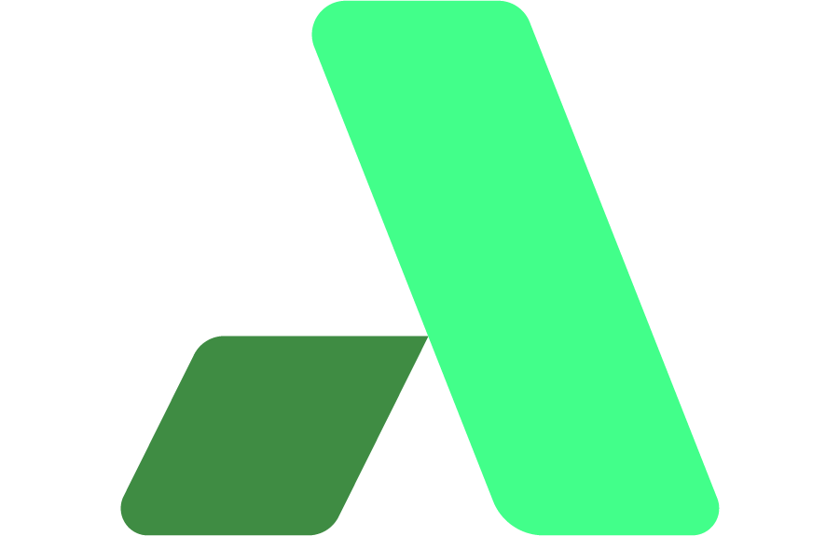
DDD SOUTHWEST · 16 MAY 2026 · ENGINE SHED, BRISTOL
2026: The Year of the
Software Factory
Building AI systems that build software
Rich Woollcott
Technical Co-founder · Appmilla
appmilla
Notes:
[~30s]
OPEN
"Morning,— I'm Rich Woollcott."
BEATS
• Technical Co-founder at Appmilla, Bristol-based consultancy.
• Today's talk is a look at how AI is changing the way we build software — with an engineering approach rather than vibe coding.
• Sharing my experiences and a look ahead to what's coming
VERBATIM
"2026 is the year of the software factory — and the worker just changed."
BRIDGE → Slide 2
"Quick about-me, then then let's get into it."

Slide 2
ABOUT ME
Rich Woollcott
Technical Co-founder · Appmilla · Bristol, UK
ROLE
FOCUS
Software Engineer — 25+ years building production systems.
Autonomous multi-agent software development systems.
HARDWARE
SHARING
Fine-tuned models on local NVIDIA DGX Spark (GB10).
YouTube channel coming soon — @RichWoollcott. Link on the closing slide.
Today's talk is about sharing what I've built and what I've learned.
2026: The Year of the Software Factory · Rich Woollcott · Appmilla
DDD Southwest · 16 May 2026
Notes:
[~45s]
OPEN
"Brief about me — 25 years building production systems."
BEATS
• Software Engineer, now Technical Co-founder at Appmilla.
• Personal Goal - transition to an agentic engineer
• My Current Focus is on multi-agent systems — code that builds code.
• Hardware: fine-tuned models locally on an NVIDIA DGX Spark (GB10).
• Mention the YouTube channel coming soon — @RichWoollcott — that's where the deeper write-ups will live.
VERBATIM
"Sharing what I've built and what I've learned along the way."
BRIDGE → Slide 3
"Let me start with the problem we're all feeling."

Slide 3
THE WHY
AI-generated code ships faster.
It doesn't ship better.
1.7×
4.94×
↑↑
More issues in AI-assisted projects
More technical debt vs non-AI projects
Code churn rising — more written AND deleted
GitClear 2025
GitClear 2025
Industry data
You've felt this with Claude Code, Copilot or Cursor. The rest of this talk is about solving it.
2026: The Year of the Software Factory · Rich Woollcott · Appmilla
DDD Southwest · 16 May 2026
Notes:
[~60s]
OPEN
"You've probably all used Claude, Codex or Copilot. You've probably all felt this."
BEATS
• GitClear 2025: AI-assisted projects ship 1.7× more issues.
• 4.94× more technical debt versus non-AI projects.
• Code churn rising — more code written AND deleted. Net velocity is barely moving.
• Faster output, worse outcomes — that isn't a win.
VERBATIM
"AI-generated code ships faster. It doesn't ship better."
BRIDGE → Slide 4
"So how do we fix it? The answer's older than most of us in this room."

Slide 4
GROUNDING THE IDEA
The concept dates to the 1960s.
What's new is the worker.
OLD PRINCIPLES
THE NEW WORKER
R.W. Bemer, GE (1969)
  standardised tools to reduce variability
McIlroy, AT&T (1968)
  systematic reusability
Modern definition
  "a repeatable, well-defined path to create and update software"
Standardisation · specialisation · quality control · conveyor sequencing
1960s – 2020s
  human developers on the line
2026
  AI agents on the line
Same proven manufacturing principles.
Applied to a new type of worker.
2026: The Year of the Software Factory · Rich Woollcott · Appmilla
DDD Southwest · 16 May 2026
Notes:
[~60s]
OPEN
"Software factories date to the 1960s. This isn't a new idea."
BEATS
• A repeatable, well-defined path to create and update software.
• Same four manufacturing principles: standardisation, specialisation, quality control, conveyor sequencing.
• The key difference is the worker used to be a human developer, now it's an AI agent.
• The recipe is the same
• Watch the room relax — they realise this is engineering, not magic.
VERBATIM
"Same proven manufacturing principles. Applied to a new type of worker."
BRIDGE → Slide 5
"Where you sit on this spectrum matters."

Slide 5
LOCATE YOURSELF
Where are you on this spectrum?
LEFT OF SPECTRUM
MIDDLE
RIGHT OF SPECTRUM
Vibe Coding
Agent Swarms
Software Factory
Claude/Codex/Copilot YOLO
Fast, cheap, fragile
No quality gates
No architecture
RuFlow · Gas Town
More structure, more tokens
Quality via swarm consensus
Throughput-optimised
Structured pipeline
Slower setup, reproducible
Quality enforced structurally
Architecture first
Swarms aren't wrong — they optimise throughput. Factories optimise correctness. Different goals.
2026: The Year of the Software Factory · Rich Woollcott · Appmilla
DDD Southwest · 16 May 2026
Notes:
[~75s]
OPEN
"Before anything else — locate yourself on this spectrum."
BEATS
• Left: Vibe coding. Claude/Codex/Copilot. Fast, cheap, no architecture.
• Middle: Agent swarms — RuFlow, Gas Town/City. Real engineering, optimised for throughput.
• Right: Software factory. Structured pipeline, quality enforced structurally.
• Steve Yegge's "seven stages of AI coding" is a useful self-location framework.
• Acknowledge swarms (60+ parallel agents, Kubernetes for AI agents) as genuine engineering — they're solving a different problem.
VERBATIM
"Swarms optimise throughput. Factories optimise correctness. Different goals."
BRIDGE → Slide 6
"Wherever you sit — the ground is shifting under you."

Slide 6
ECONOMICS
The free buffet is ending.
Know what you're building on.
LAST 3 WEEKS
RISK SPECTRUM
Anthropic (13 May, just dropped)
  From June 15, Claude Agent SDK + claude -p programmatic access removed from subscription plans. API keys required.
GitHub Copilot
  Usage-based billing from June 1. Annual plans retired. Opus model multiplier jumping 7.5× → 27×.
Root cause
  Subscriptions priced for chat. Agentic workloads consume 10–100× more tokens.
Full Cloud
Lowest setup
Highest ongoing cost
Least control
Hybrid
Moderate setup
Predictable cost
Some control
Full Local
Highest setup
Zero marginal cost
Full control
"If you build on managed infrastructure, the economics can change at any time — and you don't get to vote."
2026: The Year of the Software Factory · Rich Woollcott · Appmilla
DDD Southwest · 16 May 2026
Notes:
[~75s]
OPEN
"Three days ago, Anthropic dropped a big one."
BEATS
• From June 15 — Claude Agent SDK and `claude -p` (programmatic / headless mode) need API keys. Subscriptions = chat-only.
• Anyone who's scripted Claude Code into a pipeline or using an agent swarm will be affected..
• GitHub Copilot mirrors this changing to usage-based from June 1.
• Root cause: subscriptions priced for chat. Agentic workloads consume 10–100× more tokens.
• Risk spectrum: full cloud → hybrid → full local. Setup costs invert.
• The key point is to consider the risk management of the platform you are building on.
VERBATIM
"If you build on managed infrastructure, the economics can change at any time."
BRIDGE → Slide 7
"Here's how I actually work day to day."

Slide 7
DAILY REALITY
Claude Desktop → Claude Code → Runbooks
1
Claude Desktop (MacBook)
Ideation · build plans · scopes · phases
2
Claude Code (VS Code)
/system-arch → /system-design → /system-plan → /feature-spec → /feature-plan → AutoBuild. Build-plan status updates as we go.
3
Runbooks (GB10, autonomous)
Agent coordination · infrastructure setup · fine-tuning · evaluation · smoke tests — zero human interaction.
Build plans + scope docs enable switching between 3–5 projects simultaneously. Hard, but possible.
2026: The Year of the Software Factory · Rich Woollcott · Appmilla
DDD Southwest · 16 May 2026
Notes:
[~60s]
OPEN
"Concrete reality. Three tools, in order."
BEATS
• Claude Desktop on MacBook — ideation, build plans, scopes, phases.
• Claude Code in VS Code — runs the slash-command stack: arch → design → plan → spec → AutoBuild.
• Runbooks on the Spark — fully autonomous: agents coordinate, infrastructure spins up, fine-tuning runs, smoke tests fire.
• Build plans + scope docs are what enable parallel projects — I run 3-5 in flight at once.
VERBATIM
"Runbooks on the Spark setup infrastructure with little interaction. Build Plans help context switching."
BRIDGE → Slide 8
"Underneath that workflow there's a stack of primitives."

Slide 8
THE SLASH-COMMAND STACK
Before any code is written, we've produced
architecture, design, specs, and a plan.
SYSTEM LEVEL
/system-arch — C4 diagrams, ADRs, component boundaries
/system-design — schemas, contracts, data flows
/system-plan — phase sequencing, cohort grouping
FEATURE LEVEL
/feature-spec — BDD / Gherkin acceptance criteria
/feature-plan — ordered task list + implementation plan
autobuild feature — implement tasks in parallel waves
TASK LEVEL
/task-work — implement a single unit of work
/task-complete — mark done, update build plan
/task-review — research the problem, generate a plan with tasks
Code is the last thing that happens. Process discovered through use, then encoded.
2026: The Year of the Software Factory · Rich Woollcott · Appmilla
DDD Southwest · 16 May 2026
Notes:
[~50s]
OPEN
"Three levels — system, feature, task. Each has its own slash commands."
BEATS
• System level: arch produces C4 + ADRs. Design produces schemas. Plan sequences phases.
• Feature level: spec produces BDD acceptance criteria. Plan orders tasks. AutoBuild runs them in parallel waves.
• Task level: work, complete, review. The smallest unit.
• The code is the LAST thing that happens. Architecture, design, specs, plan — they all come first.
• I observed that I pretty much always accepted the defaults. This led to the idea of automating this and the first steps towards a software factory.
VERBATIM
"Every tool in this stack started as a pattern I noticed while using Claude Code. Discovered through use, then encoded."
BRIDGE → Slide 9
"Here's what all this looks like wired up."

Slide 9
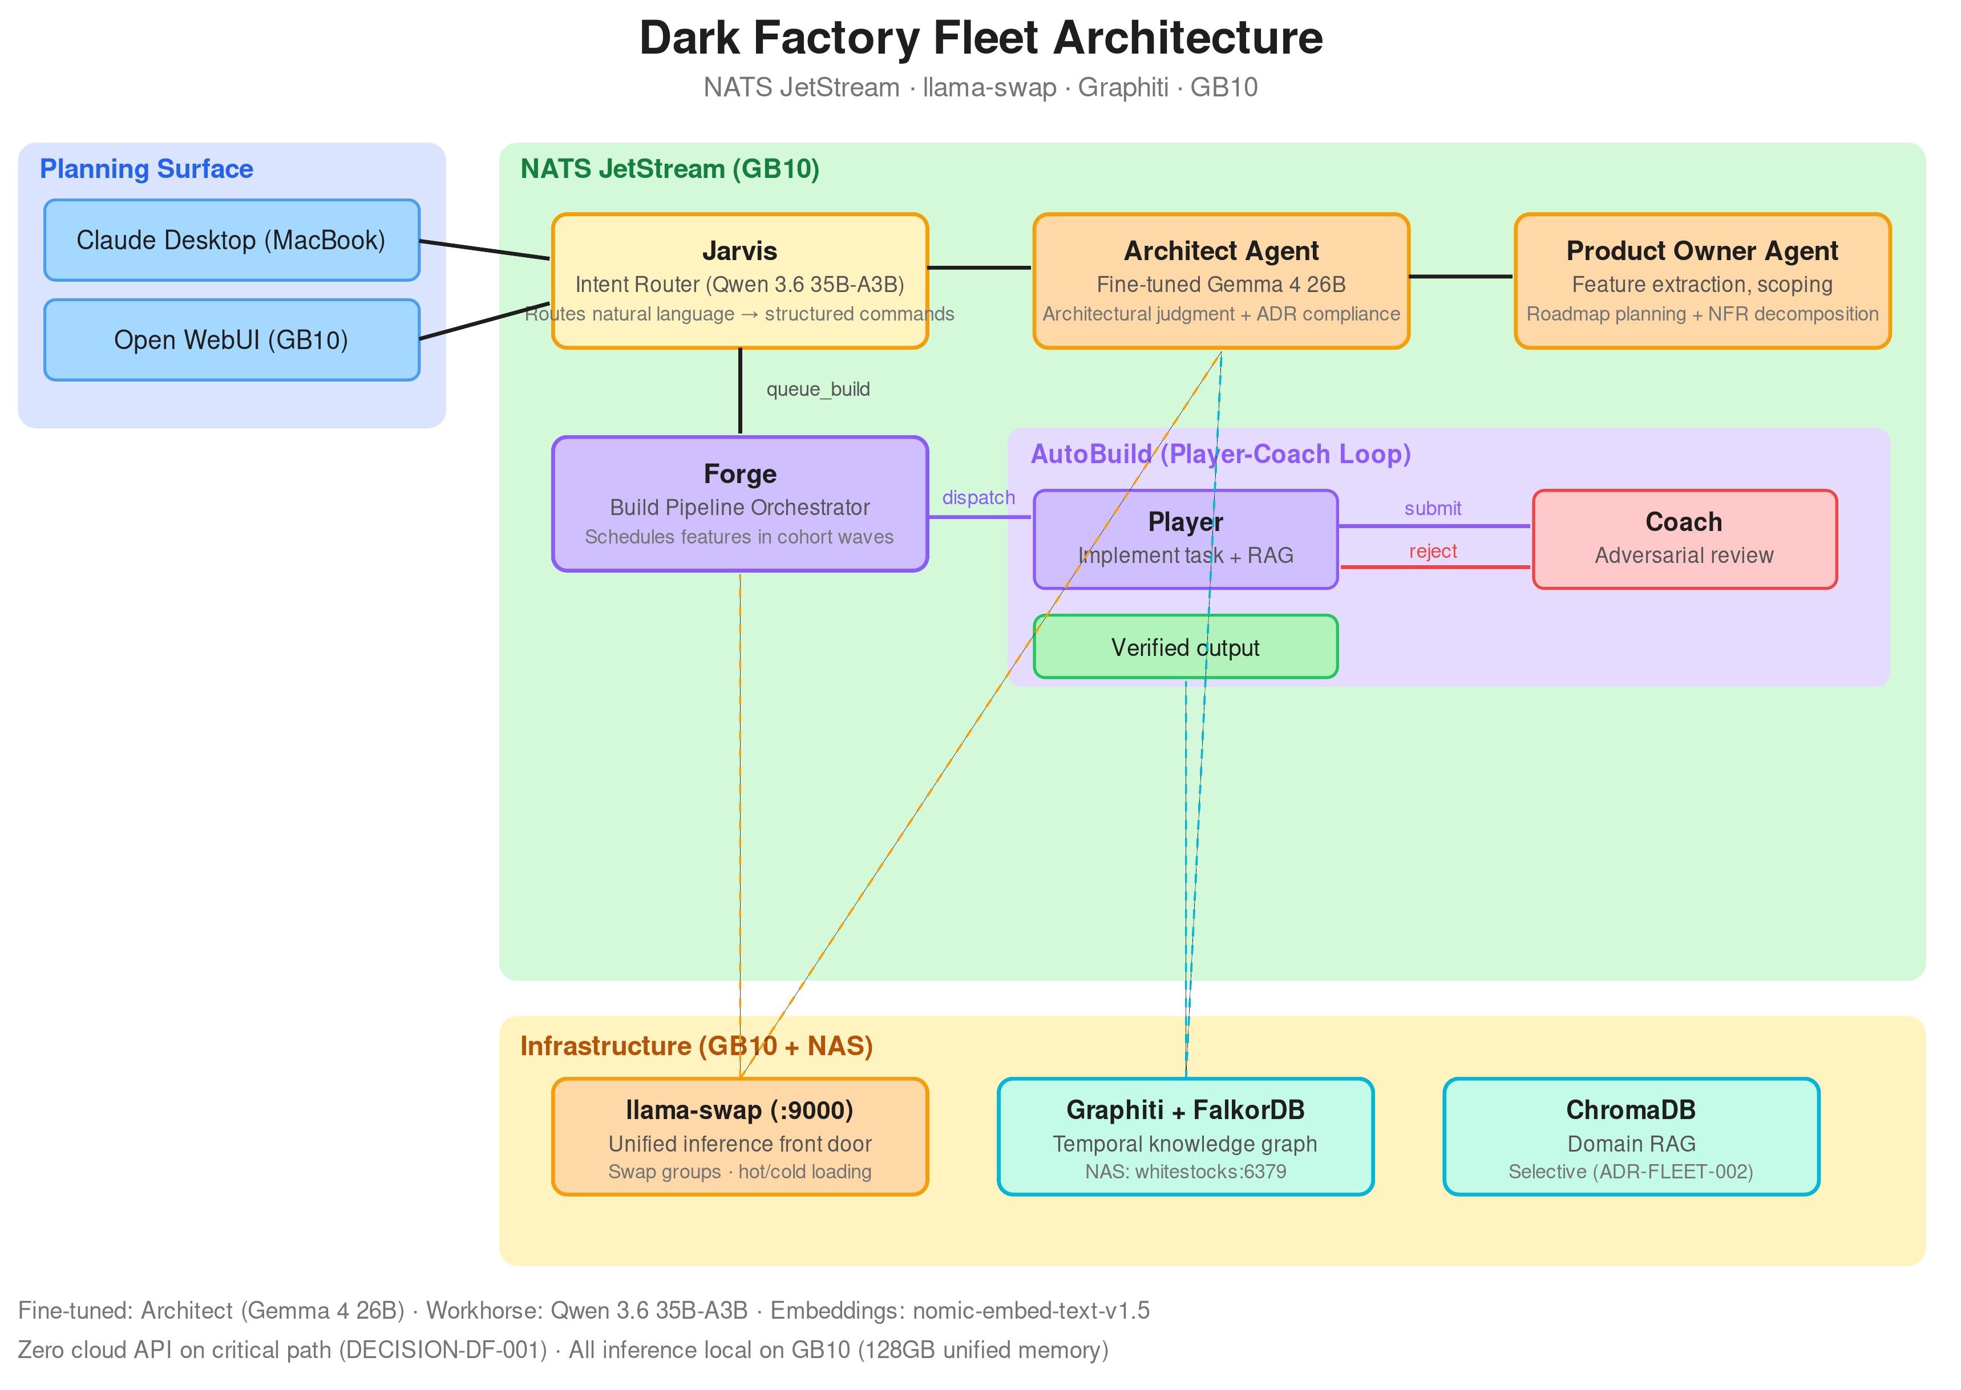
THE FACTORY
The Fleet Architecture — infrastructure and agents run on the DGX Spark.
2026: The Year of the Software Factory · Rich Woollcott · Appmilla
DDD Southwest · 16 May 2026
Notes:
[~90s · the big diagram, take your time]
OPEN
"This is the actual system. It runs on the Spark."
BEATS
• Top-left planning surface: Claude Desktop, Open WebUI — natural language comes in.
• Jarvis routes intent. Forge schedules. Architect Agent gives architectural judgment. PO Agent plans roadmaps.
• AutoBuild is the Player-Coach loop used to implement features.
• Bottom infrastructure: llama-swap is the single inference endpoint. Graphiti is the temporal memory. ChromaDB is the RAG.
• Zero cloud API on the critical path. All inference local on a 128GB GB10.
VERBATIM
"Every model through one endpoint. Every agent reads and writes the same knowledge graph."
BRIDGE → Slide 10
"The most important pattern in that diagram is this one."

Slide 10
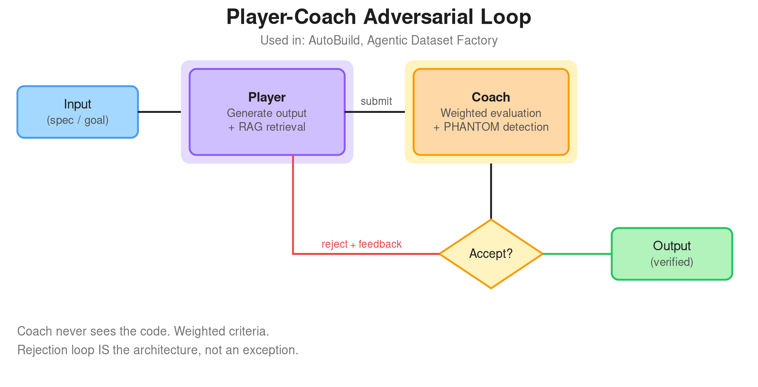
QUALITY GATE
The Player-Coach Loop — adversarial cooperation/validation.
The single most important pattern in the software factory.
2026: The Year of the Software Factory · Rich Woollcott · Appmilla
DDD Southwest · 16 May 2026
Notes:
[~75s]
OPEN
"This is where the quality comes from. The Player generates, the Coach evaluates and we loop until it's accepted."
BEATS
• This is my big shiny hammer that I've used in most of the agents.
• Player has access to RAG, and memory and generates the output.
• Coach has never seen the code — only the spec + weighted criteria. Adversarial by design.
• Rejection IS the architecture, not an exception. Validation rarely succeeds first try.
• PHANTOM detection catches the agent referencing components that don't exist.
• Anthropic confirmed it: if you ask an agent to evaluate its own work, it will praise it.
VERBATIM
"Validation contracts are written BEFORE code. The tests confirm decisions — they don't catch bugs."
BRIDGE → Slide 11
"But quality gates alone aren't enough. You also need memory."

Slide 11
MEMORY
Without memory, the agent sees the world
through a letterbox.
THE PROBLEM
THE SOLUTION · GRAPHITI
Agent hits a bug during AutoBuild.
Goes off fixing it — stochastic LLM tangent.
While "fixing," undoes core architectural decisions.
Sees the immediate problem, no awareness of the bigger picture.
Human course-corrects constantly — cognitive load doesn't reduce, it shifts.
Before task
  READ architecture decisions, constraints, prior outcomes.
During task
  WRITE decisions made, assumptions, issues discovered.
After task
  Next task reads what previous task did and why.
Temporal knowledge graph — institutional memory that compounds.
2026: The Year of the Software Factory · Rich Woollcott · Appmilla
DDD Southwest · 16 May 2026
Notes:
[~60s]
OPEN
"Without memory, your agent sees the world through a letterbox."
BEATS
• Bug fixes undo the architecture that the model is unaware of.
• You can see the problem. You can't see the bigger picture.
• That's why so often using raw Claude/Codex/Copilot falls apart at scale — YOU become the memory.
• This makes it really hard to work in parallel
• Solution: Graphiti knowledge graph.
• Before each task: READ prior decisions, constraints, outcomes. During: WRITE. After: next task reads.
VERBATIM
"The cognitive load doesn't go away. It shifts from writing code to policing the agent."
BRIDGE → Slide 12
"So with memory + quality gates wired up — small models can compete."

Slide 12
EVIDENCE
A 26B fine-tuned model matches
GPT-5.5 at $0.00.
$0.15–$0.30
GPT-5.5 · per session
20s warm latency
vs
$0.00
Gemma 4 26B · per session
10s warm latency
WHAT THE RESEARCH SAYS
WHAT WE PROVED
NVIDIA Research — "SLMs are the future of agentic AI" (arXiv:2506.02153)
Heterogeneous: SLMs for operations, LLMs for strategy
10–30× cost reduction on specialised tasks
Fine-tuned Gemma 4 26B vs GPT-5.5 on architecture reviews
3 of 4 sessions — comparable or better judgment
Honest: Session 1 failed (training data gap). Frontier models still win on broad reviews.
2026: The Year of the Software Factory · Rich Woollcott · Appmilla
DDD Southwest · 16 May 2026
Notes:
[~75s]
OPEN
"A 26B fine-tuned model matches GPT-5.5 at zero dollars."
BEATS
• Fine-tuned Gemma 4 26B vs GPT-5.5 on architecture reviews — 4 sessions. No RAG
• Three out of four: comparable or better judgment from the SLM.
• Cost: $0.00 vs $0.15-$0.30 per session. Latency: 10s warm vs 20s.
• Be honest: session 1 failed — schema error from a training data gap.
• Broad reviews still favour frontier models. Focused domain tasks — gap closes fast.
• Knowledge came from 2,200 training examples harvested from 19 architecture books via the Player-Coach loop.
VERBATIM
"NVIDIA Research said SLMs are the future of agentic AI. I'm wanted to see it for myself."
BRIDGE → Slide 13
"So how do you actually fine-tune one?"

Slide 13
AGENTIC DATASET FACTORY
You don't need to be an ML engineer
to fine-tune a model.
GOAL.md
Player-Coach
JSONL
Fine-tuned
▶
▶
▶
+ source PDFs
loop
validated
model
BEHAVIOUR LAYER
KNOWLEDGE LAYER
train.jsonl teaches HOW to respond — vocabulary, judgment calibration, response shape.
rag_index/ provides WHAT to draw from — independently upgradeable from the model weights.
No Python. No notebooks. No ML expertise. Adding a new domain = a config change, not code.
2026: The Year of the Software Factory · Rich Woollcott · Appmilla
DDD Southwest · 16 May 2026
Notes:
[~50s]
OPEN
"You don't need to be an ML engineer to do this."
BEATS
• I built an agent which creates training datasets from source PDF's
• Goal.md + source PDFs go in. JSONL training data + RAG index come out.
• The same Player-Coach loop generates AND validates training examples automatically.
• Two independently upgradeable layers: behaviour (the weights) and knowledge (the RAG).
• Adding a new domain is a config change, not code.
• No Python notebooks. No ML expertise required.
• Runbook for Claude to run smoke tests then run the agent and leave for 50-60 hours.
• Fine-tune via Unsloth using a script
VERBATIM
"The same loop that builds the software also builds the training data."
BRIDGE → Slide 14
"Put it all together — four layers, one system."

Slide 14
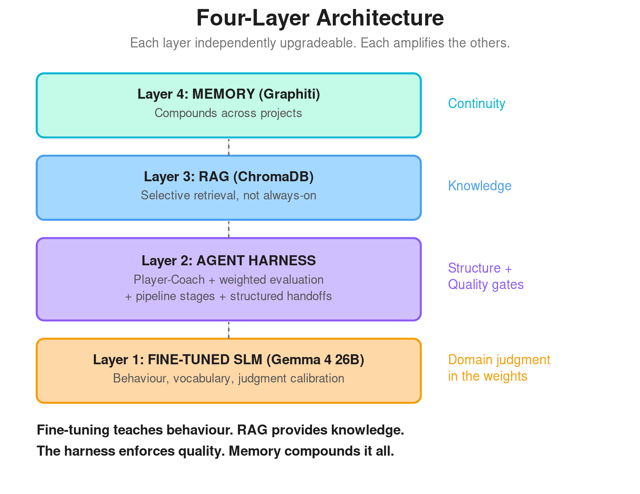
THE STACK
Four layers, one system.
Each layer independently upgradeable. Each amplifies the others.
Fine-tuning teaches behaviour. RAG provides knowledge. The harness enforces quality. Memory compounds it all.
2026: The Year of the Software Factory · Rich Woollcott · Appmilla
DDD Southwest · 16 May 2026
Notes:
[~70s]
OPEN
"Layer 1 is the fine-tuned SLM. Behaviour, judgment, calibration in the weights."
BEATS
• You can also use frontier models - the Product Owner agent uses GPT 5.5.
• Layer 2 is the harness — Player-Coach loop, optionally weighted evaluation.
• Layer 3 is RAG — selective retrieval, not always-on.
• Layer 4 is memory — Graphiti — continuity across projects.
• Each layer amplifies the others.
• Harness Engineering research: same model, 6× performance gap from harness changes alone. LangChain went outside-top-30 to rank 5 on Terminal Bench 2 by changing only the harness. Haiku outranked larger models.
VERBATIM
"Fine-tuning teaches behaviour. RAG provides knowledge. The harness enforces quality. Memory compounds it all."
BRIDGE → Slide 15
"And those layers compound."

Slide 15
COMPOUNDING
Each primitive makes the next one
more effective.
?
▤
▶
✓
∞
▶
▶
▶
▶
Research
Plan
Implement
Verify
Knowledge
↺ feeds back
You don't need all six primitives on day one. Start with one quality gate. Then add structured specs. Then add architecture.
Project 10 benefits from projects 1–9.
2026: The Year of the Software Factory · Rich Woollcott · Appmilla
DDD Southwest · 16 May 2026
Notes:
[~45s]
OPEN
"Each primitive in the pipeline makes the next one more effective."
BEATS
• Research → Plan → Implement → Verify → Knowledge feeds back into Research.
• Pre-empt the objection: "that's a lot of work upfront." Answer: each piece compounds.
• You don't need all six on day one. Start with one quality gate. Then specs. Then architecture.
• Vibe coding feels faster but doesn't compound. Project 10 starts from zero.
VERBATIM
"Each Project builds on the lessons learned from the previous ones."
BRIDGE → Slide 16
"And I'm not the only one finding this pattern."

Slide 16
EXTERNAL VALIDATION
Same patterns. Different scale.
Same conclusion.
WHAT WE BUILT
WHAT FACTORY BUILT INDEPENDENTLY
Serial pipeline, local hardware
Fine-tuned models in specific seats
Adversarial Player-Coach
Serial execution (16-day missions)
Validation contracts before code
Adversarial validation, structured handoffs
Structure and discipline beat raw model capability.
2026: The Year of the Software Factory · Rich Woollcott · Appmilla
DDD Southwest · 16 May 2026
Notes:
[~60s]
OPEN
"Same patterns. Different scale. Same conclusion."
BEATS
• What I built: serial pipeline, local hardware, fine-tuned models in specific seats, adversarial Player-Coach.
• What Factory built independently: serial execution on 16-day missions, validation contracts before code, structured handoffs.
• Two teams starting from opposite ends. Convergent patterns.
• Factory is ahead of where I've got to: 16-day autonomous runs, QA agent clicking the live app, enterprise-scale production use.
• I find when building on my own I need to step back from time to time to evaluate what I'm doing. This comparison shows the patterns converge.
VERBATIM
"Structure and discipline beat raw model capability."
BRIDGE → Slide 17
"And it resolves a tension your leadership cares about."

Slide 17
ORGANISATIONAL REALITY
Productivity vs Governance —
the factory resolves the tension.
THE TENSION
HOW THE FACTORY RESOLVES IT
Leadership wants governance, standards, engineering principles.
Developers want productivity, less friction.
Result — more governance = more friction = less AI productivity gain.
Architecture decisions as context, not gates
Adversarial validation as automated quality gate
Memory as institutional knowledge
Governance is IN the process,
not ON TOP of it.
2026: The Year of the Software Factory · Rich Woollcott · Appmilla
DDD Southwest · 16 May 2026
Notes:
[~50s · brief slide]
OPEN
"Productivity versus governance is the eternal fight. The factory resolves it."
BEATS
• Leadership wants governance, standards, principles.
• Developers want productivity, less friction.
• Today's math: more governance = more friction = less AI productivity gain.
• The Factory builds it in: architecture as CONTEXT not gates. Adversarial validation as automated quality. Memory as institutional knowledge.
• Reference Kiro (AWS's agentic IDE) — spec-driven, steering files, hooks. Different mechanism, same goal.
VERBATIM
"Governance is IN the process, not ON TOP of it."
BRIDGE → Slide 18
"But none of this comes from a vendor. It comes from use."

Slide 18
TOOLING BORN FROM USE
Don't design the process then build tools.
Discover the process, then encode it.
①
Use
②
Spot
③
Extract
④
Encode
Use AI coding tools (Claude Code, Cursor) manually for real work.
Notice a pattern you do repeatedly across projects.
Lift that pattern into tooling — a slash command, a runbook, a hook.
The tooling encodes YOUR process, YOUR domain, YOUR constraints.
Later this year you'll be able to buy or download someone else's software factory. The question: does their process match YOUR process?
2026: The Year of the Software Factory · Rich Woollcott · Appmilla
DDD Southwest · 16 May 2026
Notes:
[~50s]
OPEN
"Don't design the process then build tools. Discover it, then encode it."
BEATS
• Step 1: use AI coding tools manually for real work.
• Step 2: spot the pattern you keep doing.
• Step 3: extract it into tooling — slash command, runbook, hook.
• Step 4: tooling encodes YOUR process. Not a vendor's.
• RequireKit war story: tried to give tooling to someone else, didn't work — the process encoded didn't match their mental model.
• Warning: later this year you'll be able to buy someone else's factory. Ask if their process matches yours.
VERBATIM
"The tooling encodes YOUR thinking — and that's the moat."
BRIDGE → Slide 19
"OK — what should you actually do on Monday?"

Slide 19
GENEROUS HANDOFF
What to do on Monday morning.
MONDAY MORNING
THIS QUARTER
THIS YEAR
Start one quality gate
Make the pipeline explicit
Build the factory floor
Pick one AI workflow you run regularly
Add adversarial review by a second model
Write acceptance criteria BEFORE the AI writes code
Map your pipeline stages
Try different models in different seats
Serial execution, not parallel — correctness compounds
Structured handoffs between stages
Fine-tune a model for your domain
Build a knowledge graph that compounds
Consider running locally — zero marginal cost
2026: The Year of the Software Factory · Rich Woollcott · Appmilla
DDD Southwest · 16 May 2026
Notes:
[~70s · the generous handoff]
OPEN
"Three tiers. Pick any one and give it a go."
BEATS
• Monday morning: pick one AI workflow you already run. Add adversarial review by a second model. Write acceptance criteria BEFORE the AI writes code.
• This quarter: map your pipeline stages explicitly. Try different models in different seats. Serial, not parallel.
• This year: fine-tune a model for your domain. Build a knowledge graph that compounds. Consider running it all locally.
• Pure handoff — no mention of my tools. Audience can start anywhere.
VERBATIM
"Start with one quality gate. Everything else compounds from there."
BRIDGE → Slide 20
"So where does this go next?"

Slide 20
THE ROAD AHEAD
Architect + PO agents shipped.
The pattern extends.
SHIPPED · GPT-5.5
NEXT SEAT
THE FRONTIER
Product Owner Agent
Forge / Autobuild
QA Agent
po_extract across 14 source docs → roadmap of epics → ~35 feature spec inputs
Next: fine-tune Gemma 4 to cut running cost.
Refactor from Claude Agents SDK · surface build pipeline events · handle failures.
The last 20% · clicking through the live app · currently the hardest problem — runbooks helping.
The AI is the engine. You're still the engineer.
2026: The Year of the Software Factory · Rich Woollcott · Appmilla
DDD Southwest · 16 May 2026
Notes:
[~50s]
OPEN
"Architect Agent is shipped. PO Agent is shipped. The pattern extends."
BEATS
• PO Agent runs on GPT-5.5 today — `po_extract` takes 14 source docs and produces a roadmap of epics plus ~35 feature spec inputs.
• Same Player-Coach + harness + RAG recipe, different seat.
• Next step for PO: fine-tune Gemma 4 to slash running cost — same path I walked with Architect.
• Refactoring Autobuild from Claude agents SDK and extending the Forge build event and failure handling..
• QA Agent is the frontier — Luke at Factory uses computer-use to click through live apps. Still hard.
VERBATIM
"The AI is the engine. You're still the engineer."
BRIDGE → Slide 21
"Quick set of pointers if you want to go deeper."

Slide 21

WATCH · READ · CONNECT
Go deeper.
Luke @ Factory — "Factory Missions"
YouTube · adversarial validation, serial execution
Harness Engineering
YouTube · what wraps the model matters more
Steve Yegge — Gas Town/City posts
Medium · agent swarms, seven stages, war stories
CRISPY / Dex — "Everything We Got Wrong About RPI"
YouTube · research-plan-implement evolved
NVIDIA Research — SLMs for Agentic AI
arXiv:2506.02153 · why small models win
Simon Willison — Dark Factories
Blog · the public-facing pattern catalogue
Rich Sutton — The Bitter Lesson
Essay · compute beats cleverness
QR
code
Rich Woollcott
rich@appmilla.com
YouTube · @RichWoollcott — channel coming soon
appmilla.com
appmilla
Notes:
[~30s · then Q&A]
OPEN
"Some useful references."
BEATS
• Reading list: Factory Missions, Gas Town, NVIDIA's SLM paper, Harness Engineering, Bitter Lesson, Simon Willison on dark factories.
• YouTube channel @RichWoollcott — coming soon — deeper walkthroughs will land there.
• rich@appmilla.com if you want to chat one-on-one.
• Then straight to Q&A — open the floor.
VERBATIM
"That's it hope you found the talk useful."
BRIDGE → Qpen discussion if time
"Open floor. What did this miss? What's hardest where you sit?"

